Slide 1

Fundamentals of
Electric Circuit
2020.4
Chapter 6
Capacitors and Inductors

Slide 2
Chapter 6 Capacitors and Inductors
In this chapter, we are particular interested
in the following objectives
Finding the voltage-current relationship of ideal capacitors;
Finding the voltage-current relationship of ideal inductors;
Calculating the energy stored in inductors and capacitors;

Slide 3
Methods for reducing series/parallel combinations of inductors;
Methods for reducing series/parallel combinations of capacitor;
Predicting the behavior of op amp circuits with capacitors.

Slide 4
Chapter 6 Capacitors and Inductors
6.1 Capacitors
6.2 Series and Parallel Capacitors
6.3 Inductors
6.4 Series and Parallel Inductors
6.5 Applications

Slide 5
6.1 Introduction
Unlike resistors, which dissipate energy, capacitors and inductors do not dissipate but store energy, which can be retrieved at a later time. For this reason, capacitors and inductors are called storage elements.
The circuit analysis techniques covered in Chapters 3 and 4 are equally applicable to circuits with capacitors and inductors.

Slide 6

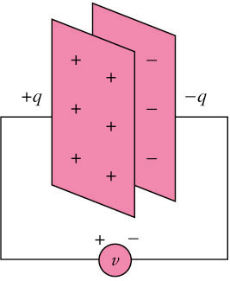
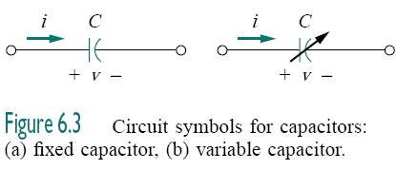
6.2 Capacitors
A capacitor is a passive element designed to store energy in its electric field.
The capacitor is said to store the electric charge.
The amount of charge stored, represented by q, is directly proportional to the applied voltage v
Capacitance C is the ratio of q to v, measured in farads (F).
Typically, capacitors have values in the picofarad (pF) to microfarad (µF) range.
Figure 5.2 A capacitor with
applied voltage v.

Slide 7
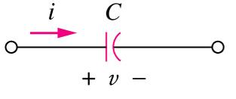
According to the passive sign convention, current is considered to flow into the positive terminal of the capacitor when the capacitor is being charged, and out of the positive terminal when the capacitor is discharging.
If i is flowing into the +v terminal of C
  Charging => i is +v
  Discharging => i is –v

Slide 8
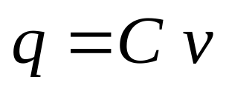
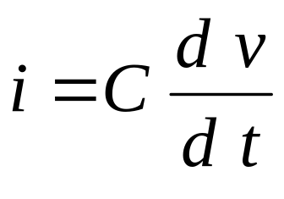

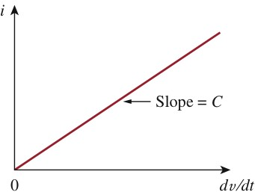
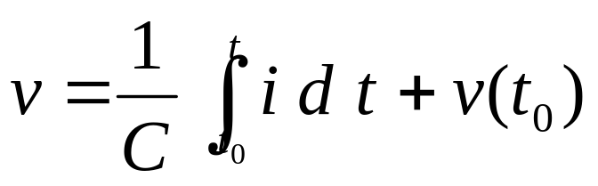
The current-voltage relationship of capacitor according to above convention is
Fig.6.6 Current-Voltage relationship of a capacitor

Slide 9
Above Equation shows that capacitor voltage depends on the past history of the capacitor current. Hence, the capacitor has memory—a property that is often exploited.

Slide 10


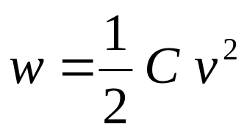
The instantaneous power delivered to the capacitor is
The energy stored in the capacitor is therefore
The energy, w, stored in the capacitor is
The energy stored in the electric field that exists between the plates of the capacitor.

Slide 11
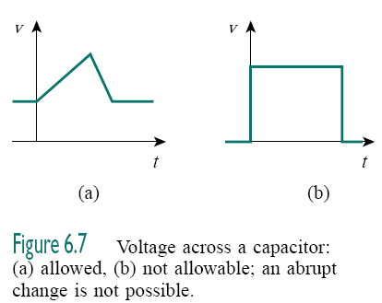
important properties of a capacitor:
1. A capacitor is an open circuit to dc (dv/dt = 0).
2. The voltage on the capacitor must be continuous.
  The voltage on a capacitor cannot change abruptly.

Slide 12

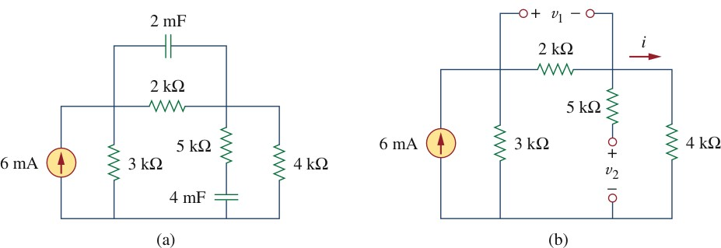






Find the energy stored in each capacitor in Fig.6.12(a) under dc conditions
Fig.6.12
Under dc conditions, we replace each capacitor with an open circuit,

Slide 13

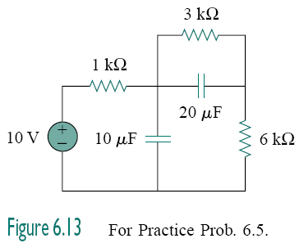


Slide 14
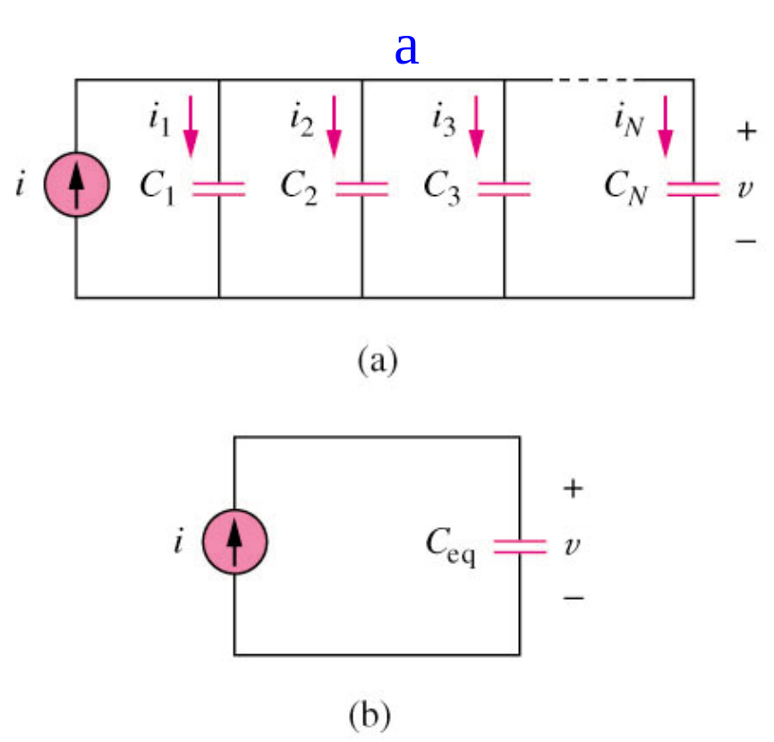
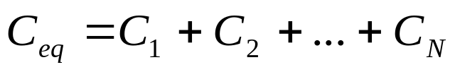





6.2 Series and Parallel Capacitors
The equivalent capacitance of N parallel-connected capacitors is the sum of the individual capacitances.

Slide 15
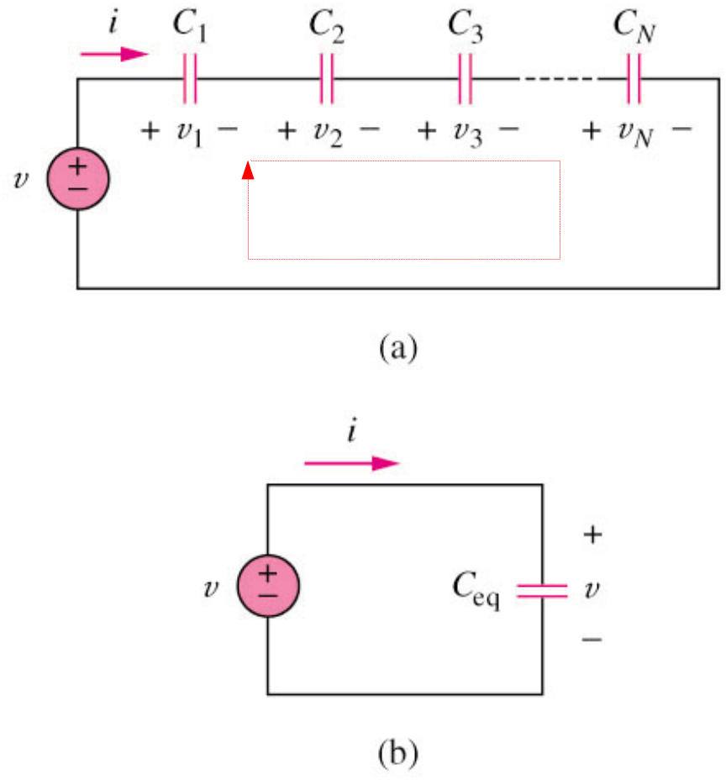
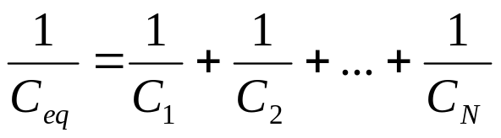


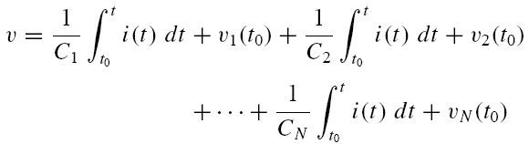
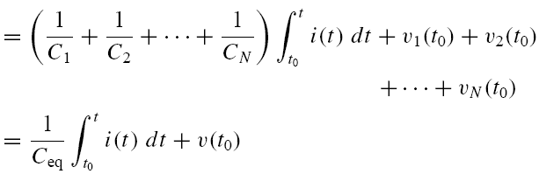
The equivalent capacitance of N series-connected capacitors is the reciprocal of the sum of the reciprocals of the individual capacitances.

Slide 16

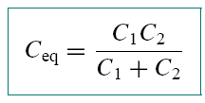
We observe that capacitors in parallel combine in the same manner as resistors in series.
Note that capacitors in series combine in the same manner as resistors in parallel.
For N = 2 (i.e., two capacitors in series),

Slide 17


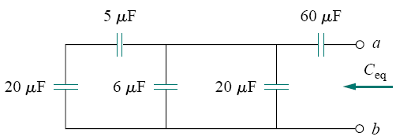
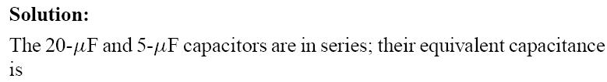





Slide 18
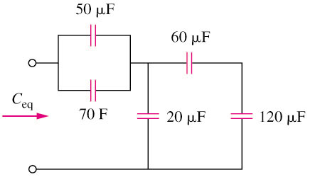
PRACTICE PROBLEM 6.6
Find the equivalent capacitance seen at the terminals of the circuit in the circuit shown below:
Answer:
C_{eq} = 40μF

Slide 19

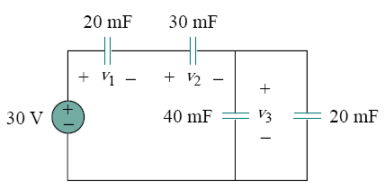
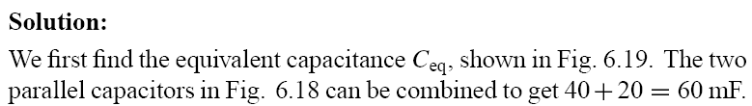




Slide 20
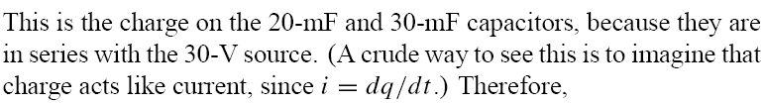




Slide 21
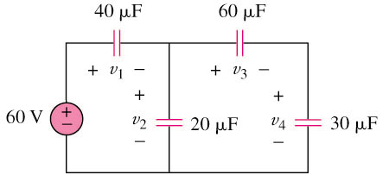
Example 4
Find the voltage across each of the capacitors in the circuit shown below:
Answer:
v₁ = 30V
v₂ = 30V
v₃ = 10V
v₄ = 20V

Slide 22
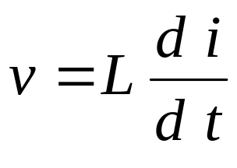
6.3 Inductors
An inductor is a passive element designed to store energy in its magnetic field.
An inductor consists of a coil of conducting wire.
If current is allowed to pass through an inductor, it is found that the voltage across the inductor is directly proportional to the time rate of change of the current. Using the passive sign convention,
where L is the constant of proportionality called the inductance of the inductor. The unit of inductors is Henry (H), mH (10^{–3}) and μH (10^{–6}).

Slide 23
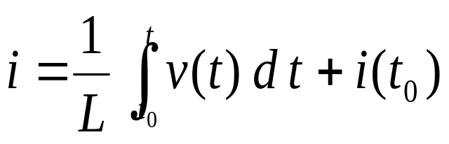
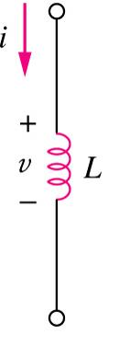

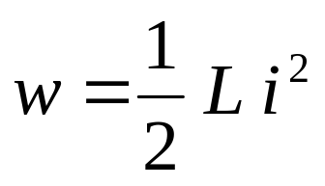
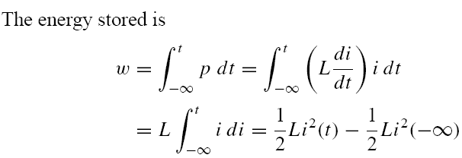
The current-voltage relationship of an inductor:
The inductor is designed to store energy in its magnetic field.
The power delivered to the inductor is

Slide 24
1.An inductor acts like a short circuit to dc (di/dt = 0) and its current cannot change abruptly.
2. The current of an inductor cannot change instantaneously.
3.Like the ideal capacitor, the ideal inductor does not dissipate energy. The energy stored in it can be retrieved at a later time.
  The inductor takes power from the circuit when storing energy and delivers power to the circuit when returning previously stored energy.

Slide 25

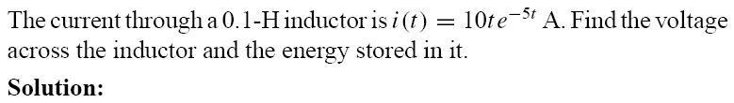





Slide 26

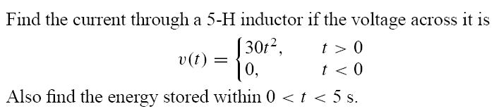





Slide 27
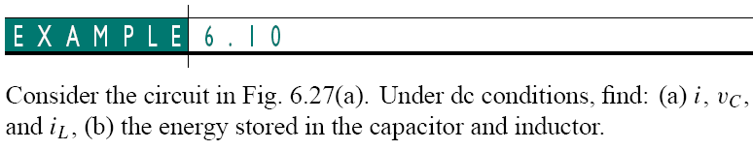
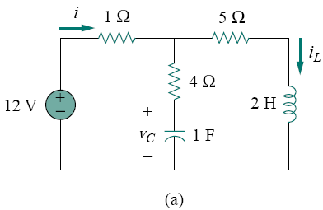
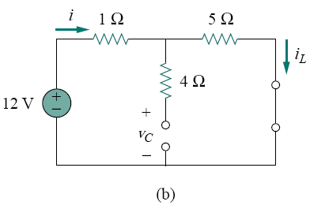
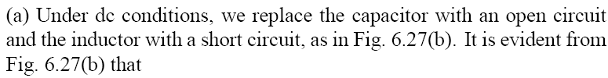



Slide 28





Slide 29
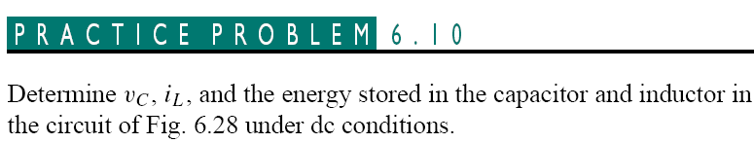
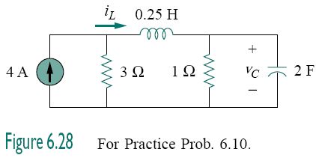


Slide 30
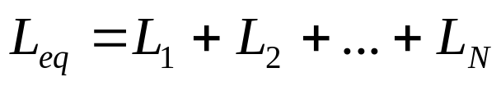
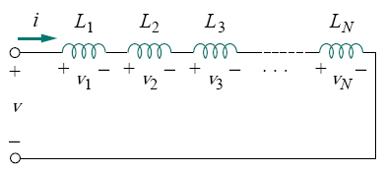


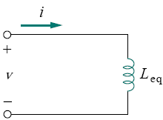
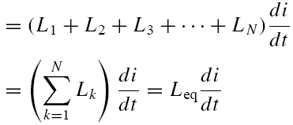
6.4 Series and Parallel Inductors
The equivalent inductance of series-connected inductors is the sum of the individual inductances.

Slide 31
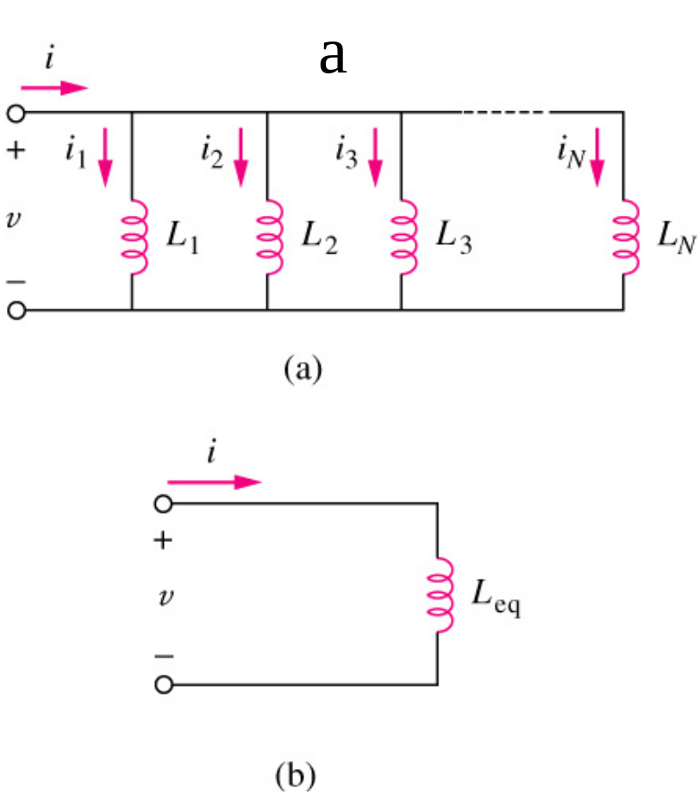


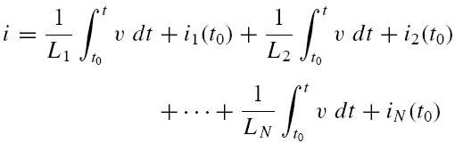
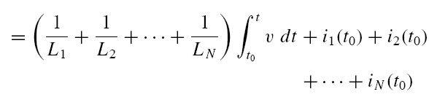
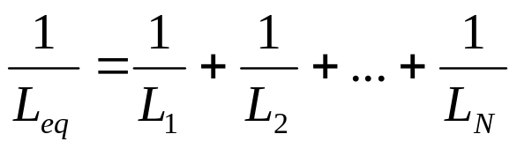

The equivalent inductance of parallel inductors is the reciprocal of the sum of the reciprocals of the individual inductances.

Slide 32

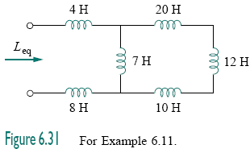
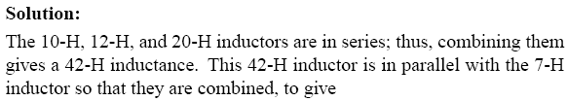



Slide 33
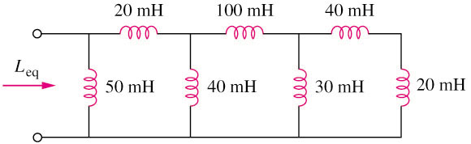
Example 6.12
Calculate the equivalent inductance for the inductive ladder network in the circuit shown below:
Answer:
L_{eq} = 25mH

Slide 34
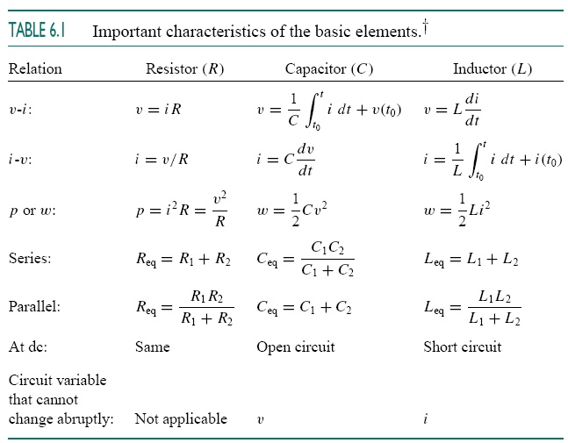
Current and voltage relationship for R, L, C

Slide 35




Slide 36





Slide 37




Slide 38
6.5 Applications
Capacitors and inductors possess the following three special properties that make them very useful in electric circuits:
The capacity to store energy makes them useful as temporary voltage or current sources. Thus, they can be used for generating a large amount of current or voltage for a short period of time.
Capacitors and inductors are frequency sensitive. This property makes them useful for frequency discrimination.

Slide 39



Slide 40







Performing nodal analysis at the inverting input,
Thus
Integrating both sides gives
Assuming

Slide 41
Integrator
An integrator is an op amp circuit whose output is proportional to the integral of the input signal.

Slide 42





Differentiator
A differentiator is an op amp circuit whose output is proportional to the rate of change of the input signal.
We can obtain from these equations

Slide 43

Summary and Review
The current through a capacitor is given by i = C dv/dt
The voltage across a capacitor is related to its current by
A capacitor is an open circuit to dc currents.

Slide 44

The voltage across an inductor is given by v = L di/dt.
The current through an inductor is related to its current by
An inductor is a short circuit to dc currents.

Slide 45
Series and parallel combinations of inductors can be combined using the same equations as for resistors.
Series and parallel combinations of capacitors work the opposite way as they do for resistor.

Slide 46
A capacitor as the feedback element in an inverting op amp leads to an output voltage proportional to the integral of the input voltage. Swapping the input resistor and the feedback capacitor leads to an output voltage proportional to the derivative of the input voltage.
Since capacitors and inductors are linear elements, KVL, KCL, superposition, Thévenin’s and Norton’s theorems, and nodal and mesh analysis apply to their circuits as well.

Slide 47
Current and voltage relationship for R, L, C

Slide 48


Homework

Slide 49





Slide 50


